Slide 1
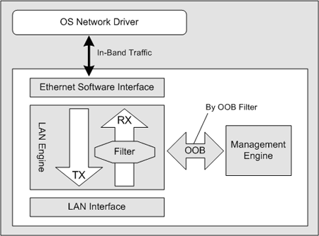

Slide 2
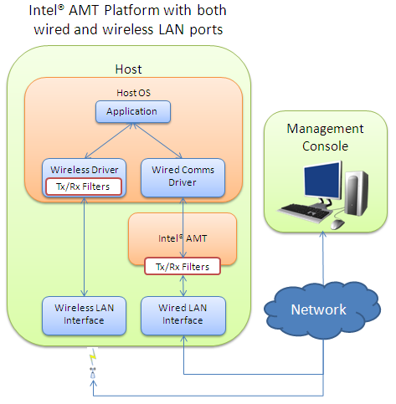

Slide 3
System Defense Policy
Allow
Filter #1
Drop
Filter #2
Rate Limit
Filter #3
Count
…
Default Action

